Slide 1

Exploratory Data Analysis
Assignment 2 : Case study - Machine learning with Energy datasets
Presented by:
Sreerag Mandakathil Sreenath, mandakathil.s@husky.neu.edu
Shreya Chudasama, chudasama.s@husky.neu.edu
Aahana Khajanchi, khajanchi.a@husky.neu.edu

Slide 2
Libraries
Matplotlib
Plotly
Seaborn
MissingNo
Pivottablejs
PandasProfiling
Ipythonwidgets.interact
Logging

Slide 3
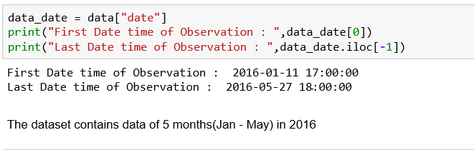
Highlights on the Dataset
Our dataset is from Jan 1st to May 27th, 2016

Slide 4
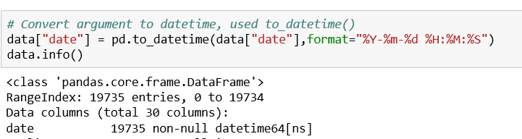
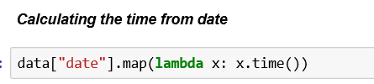
Generating New columns from date

Slide 5
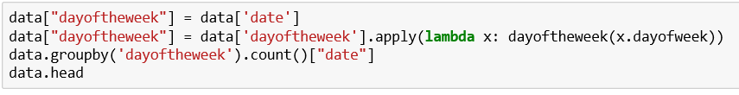
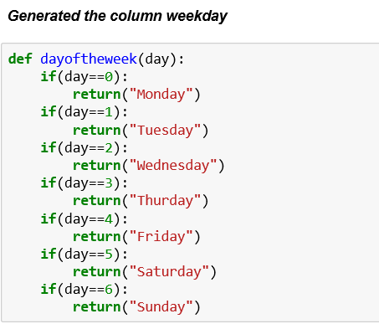
Added column day of the week using function dayofweek()

Slide 6
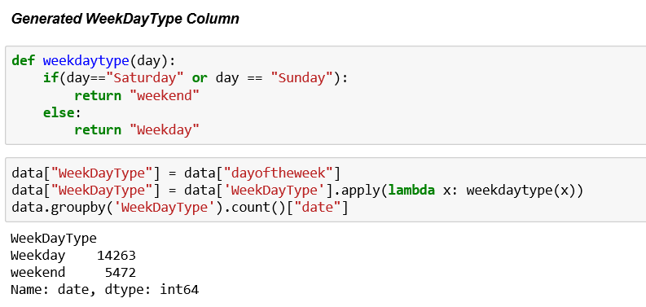

Slide 7
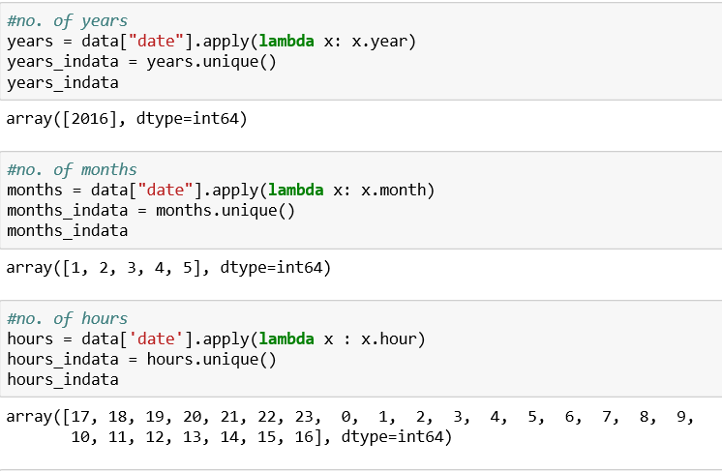
Calculated number of years, months and hours using lambda function

Slide 8
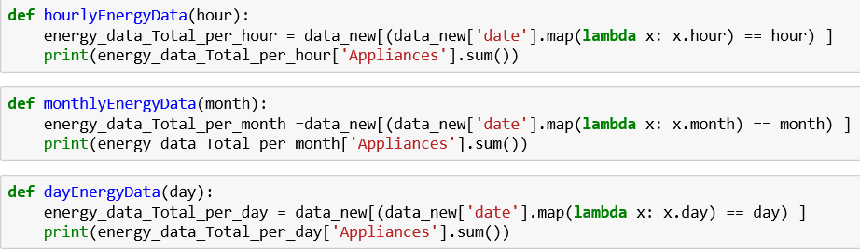
Functions- To determine Hourly, Monthly and Daily Energy Consumption

Slide 9
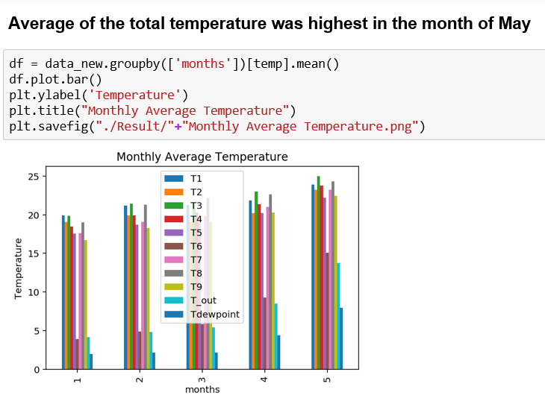
Calculated mean of Temperature for each month

Slide 10
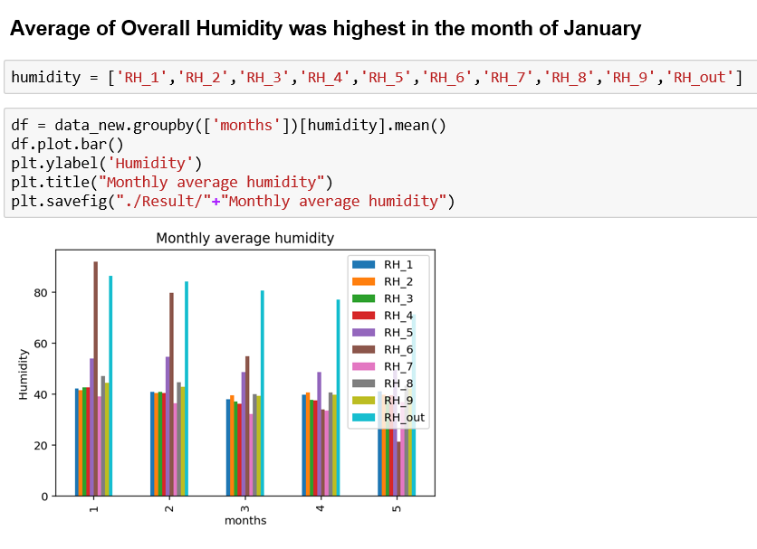
Calculated mean of Humidity for each month
The maximum humidity is due to RH_6 and Rh_out i.e. outside humidity

Slide 11
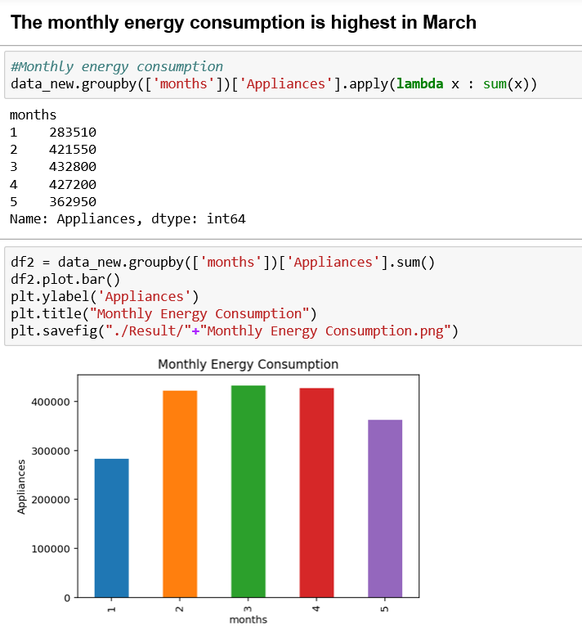
Calculated total energy consumption of appliances in a particular month

Slide 12
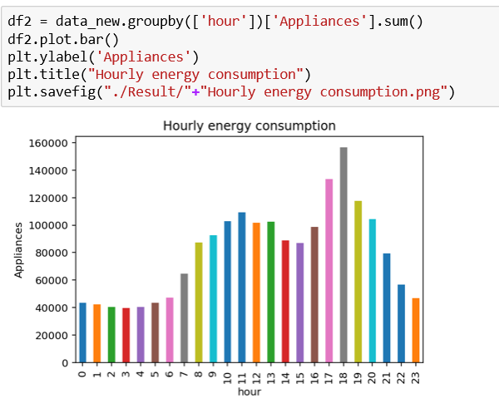
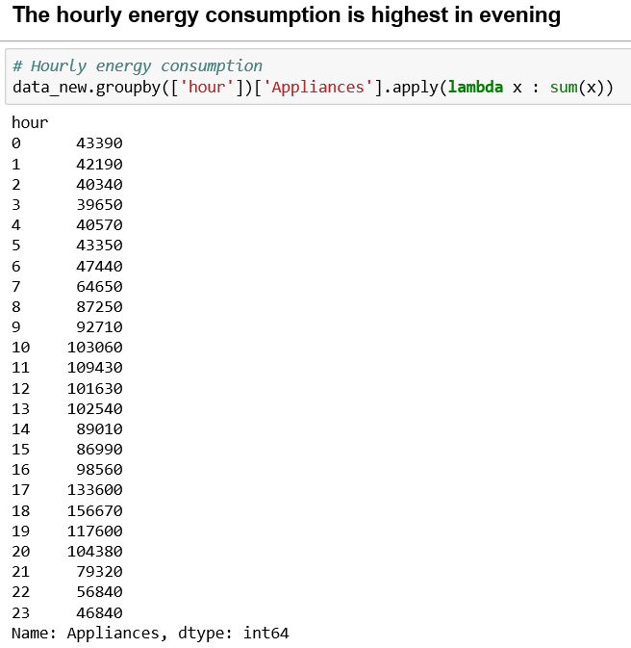
Calculated hourly consumption of total 5 months

Slide 13
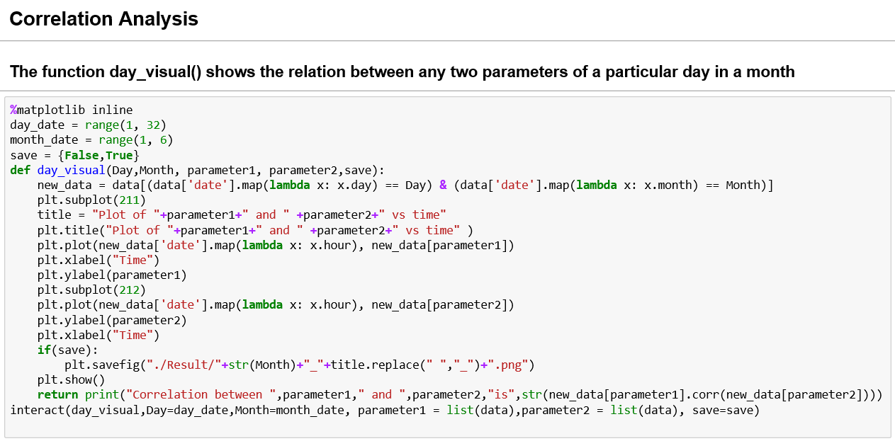

Slide 14
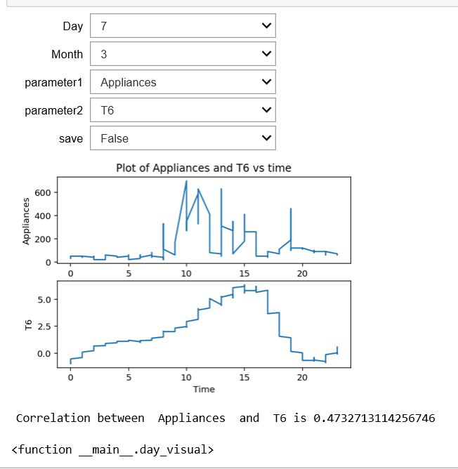
Correlation Between Any 2 Parameters of a Particular Day in a Month
Select the parameters from dropdown and analyze the relation between any 2 features wrt Time.
Observation -
On 7th March,2016. The correlation between Appliances and T6 (outside temp) is 0.47

Slide 15
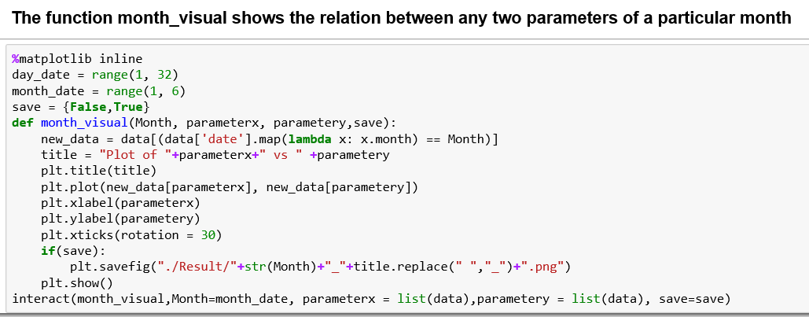

Slide 16
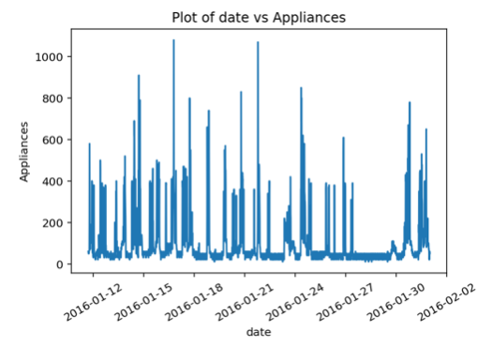
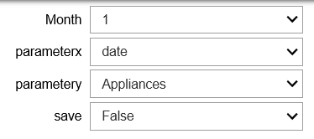
Relation Between Any 2 Parameters of a Particular Month
Observation-
Plotted graph between date and Appliances, So the maximum consumption is in mid of the month.

Slide 17
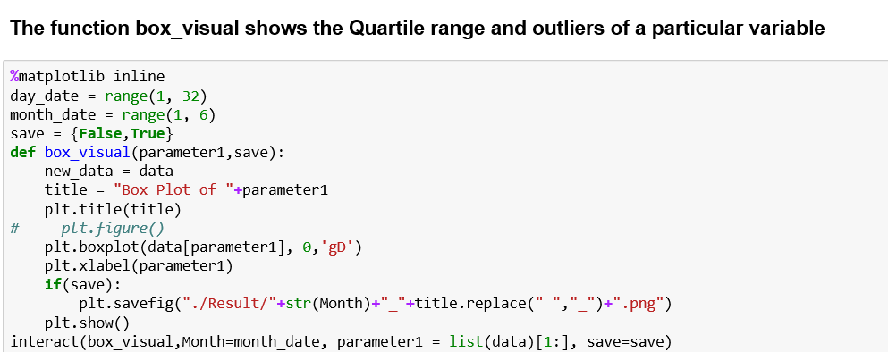

Slide 18
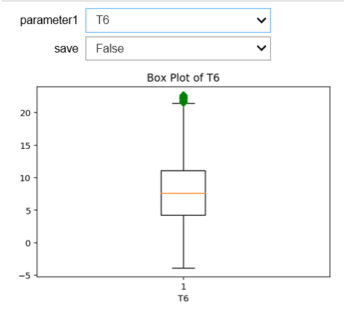
Box Plots
Boxplots are used for detecting outliers.
From the plot we can conclude that after 20, there is an outlier in T6.

Slide 19
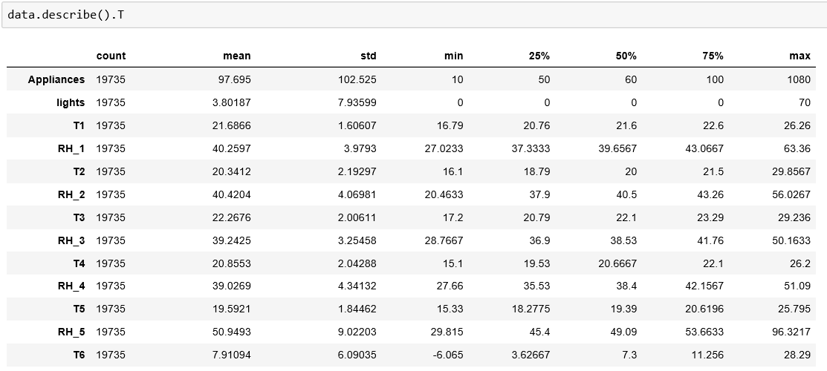
Describing the dataset
Used for calculating Outliers

Slide 20
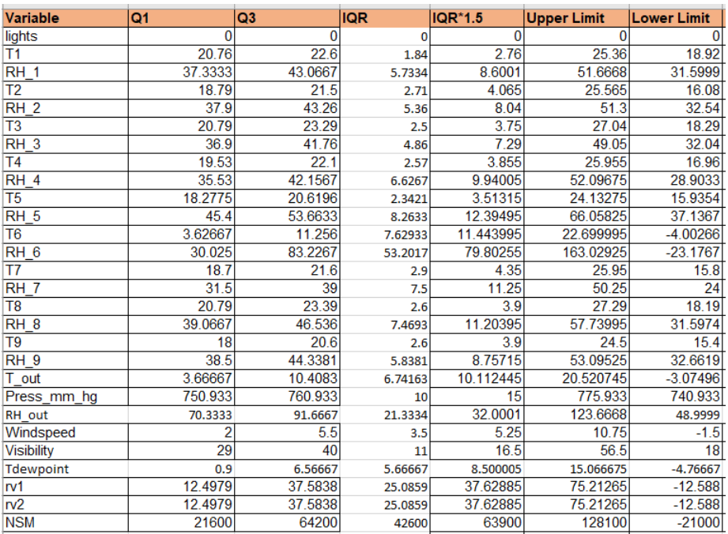
Calculation Of Outliers
Formula used for calculating outliers
Q1(1st Quartile ) = 25% = ¼ th value
Q3(3rd Quartile) = 75% = ¾ th value
IQR (Inter Quartile Range)
IQR =Q3 - Q1
The values which lie above upper limit and below lower limit are considered as outliers.

Slide 21
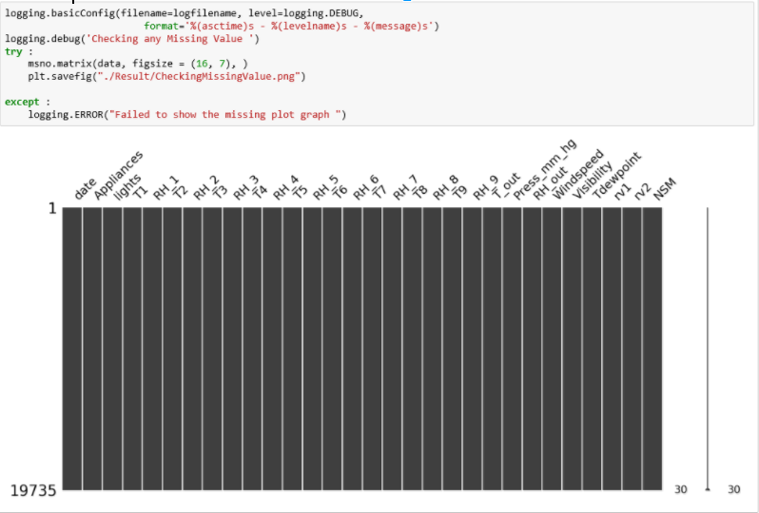
import missingno as msno - Detecting Missing Values
This is a clean dataset.
If there would be white spots in the plot then we could conclude that, it has missing values.

Slide 22
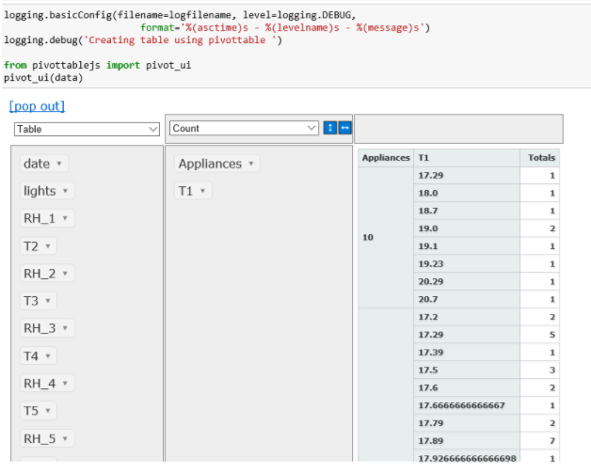
from pivottablejs import pivot_ui - Created table using Pivottable
Drag and Drop the features and you can see the pivot table.

Slide 23
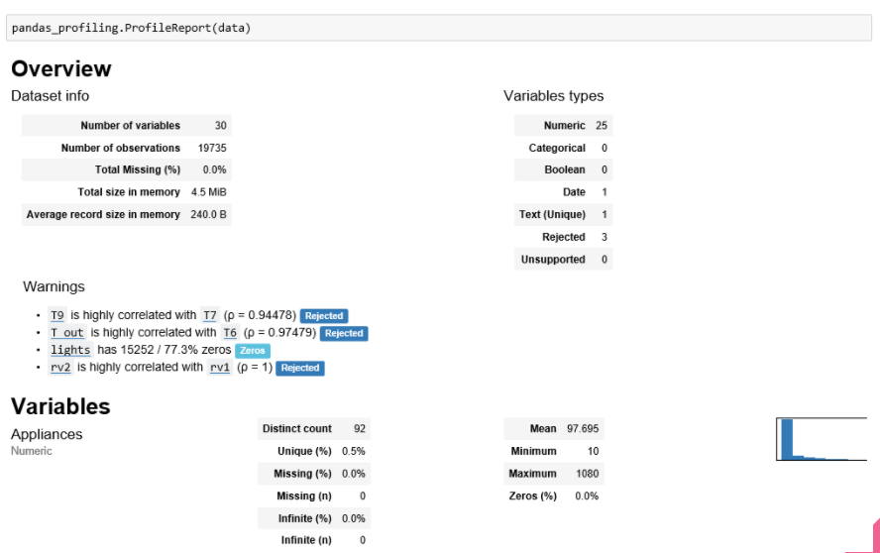
import pandas_profiling - Generating profile report that summarizes the data

Slide 24
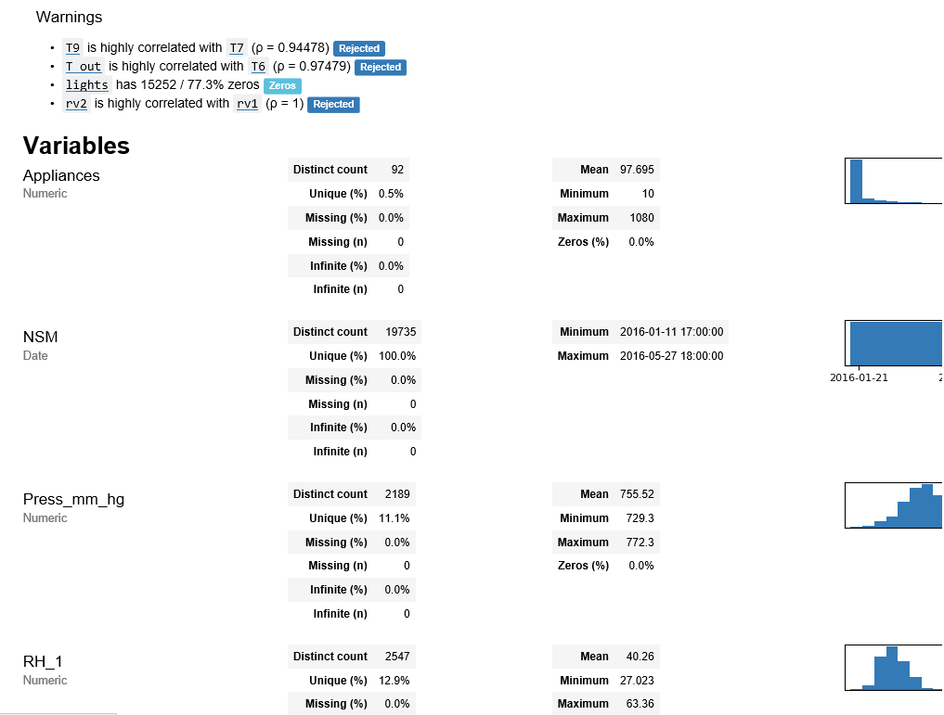

Slide 25
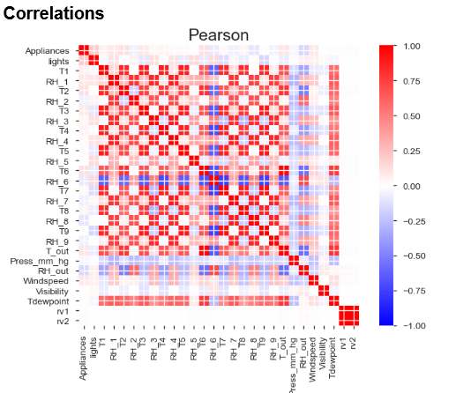
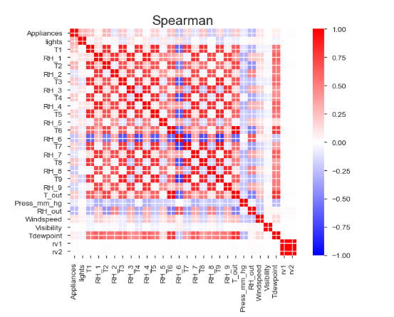
Correlation Plots

